Slide 1
Gesture control system
Team Members-
Abhinav Gupta(2100270140001)
Abhishek Garg(2100270140002)
Anshika Kumari(2100270140010)
Ayush Kumar Verma(2100270140016)

Slide 2
Introduction
We are here trying to create a creative way to interact with machine we are here trying to set a human-machine interaction using hand gestures we will we providing four basic modules which are
Volume control system using gestures
Virtual calculator using gestures
Drag and drop
Zoom in and zoom out facility

Slide 3
Technology used
To achieve this purpose, we are using following technology and modules
Programming language- Python
IDE- PyCharm
Library 1- OpenCV
Library 2- Matplotlib
Framework- Mediapipe

Slide 4
Tools used-
OpenCV-
OpenCV (Open Source Computer Vision Library) is an open source computer vision and machine learning software library. OpenCV was built to provide a common infrastructure for computer vision applications and to accelerate the use of machine perception in the commercial products.
Computer Vision can be defined as a discipline that explains how to reconstruct, interrupt, and understand a 3D scene from its 2D images, in terms of the properties of the structure present in the scene. It deals with modeling and replicating human vision using computer software and hardware.
Computer Vision overlaps significantly with the following fields −
Image Processing − It focuses on image manipulation.
Pattern Recognition − It explains various techniques to classify patterns.
Photogrammetry − It is concerned with obtaining accurate measurements from images.

Slide 5
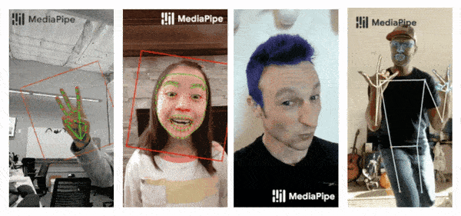
Mediapipe-
MediaPipe is a Framework for building machine learning pipelines for processing time-series data like video, audio, etc. This cross-platform Framework works on Desktop/Server, Android, iOS, and embedded devices like Raspberry Pi and Jetson Nano. This framework is given by google.

Slide 6
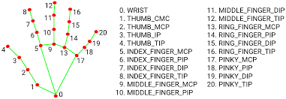
Hand landmarks-

Slide 7
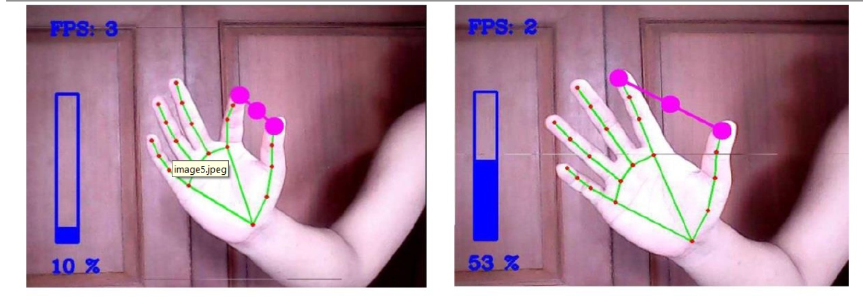
Modules-
Volume control using gestures-
In this module we will be manipulating the system volume using gestures.

Slide 8
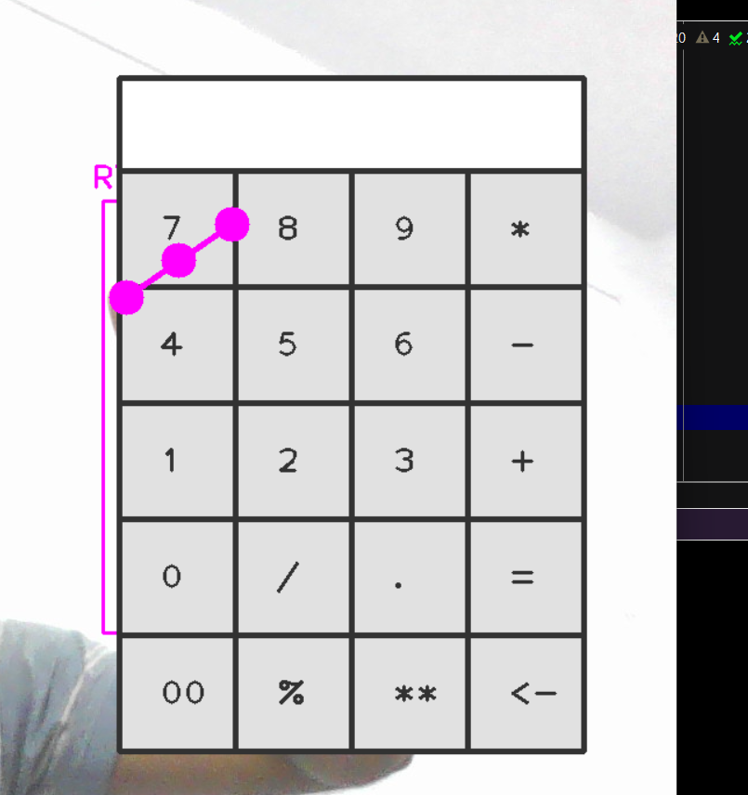
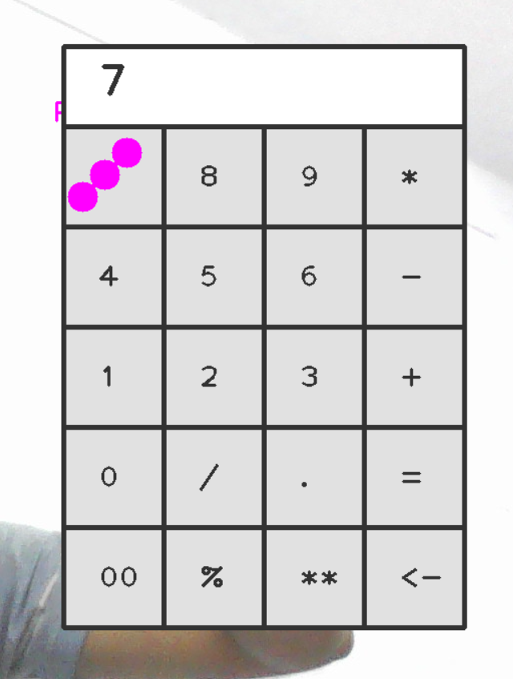
Virtual calculator-
In this module we going to use the virtual calculator to find different operation which are addition, subtraction, multiplication, power, division and many more.

Slide 9
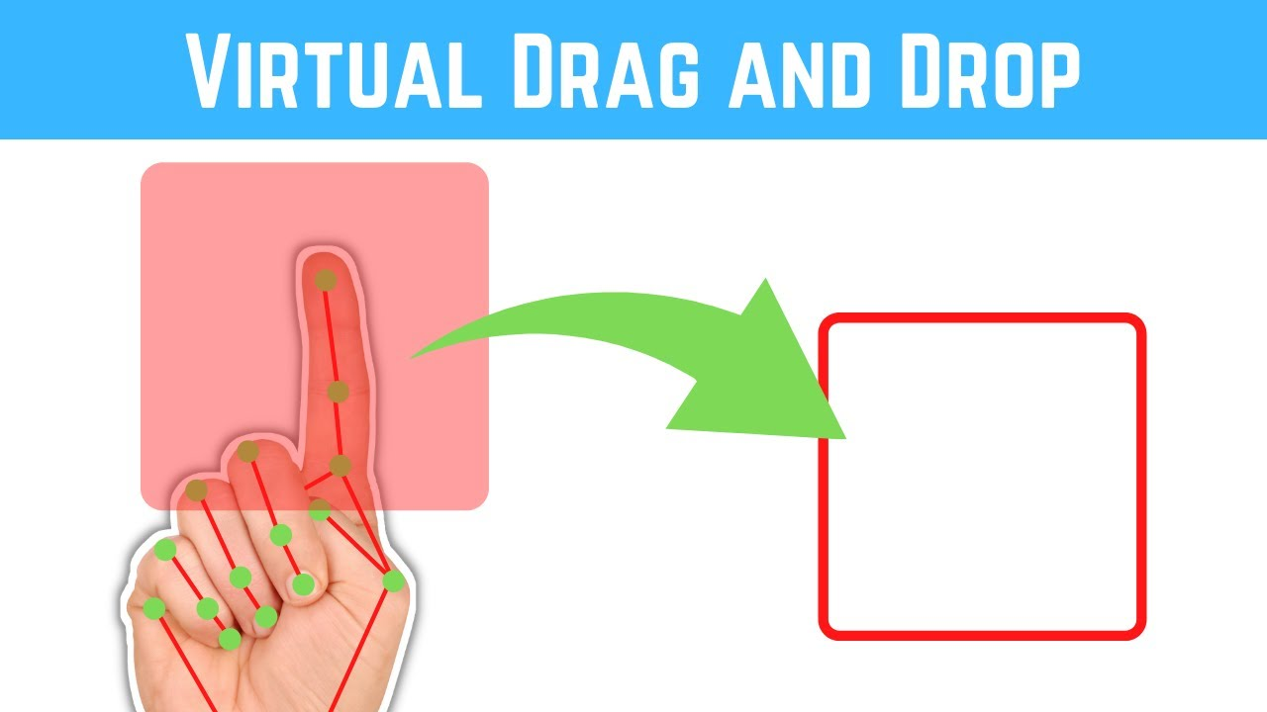
Drag and drop module-
In this module we will try to demonstrate the drag and drop using gestures.

Slide 10
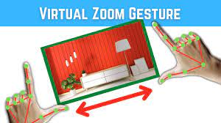
Zoom-in and zoom-out-
In this module we going to demonstrate the zoom-in and zoom out operation using gestures.

Slide 11
Thank you

